Slide 1
Agenda
Module 1: Introduction
Module 2: Commands
Module 3: Data And Streams
Module 4: Pipeline Introduction
Module 5: Introduction To Data Types
Module 6: Advanced Pipeline Operations
Module 7: Modules Introduction
Module 8: Advanced Data Types
Module 9: Functions, Scripts & Scope
Module 10: Flow Control

Slide 2
Module 4: Pipeline Introduction
Lesson 1: What is a pipeline?
Lesson 2: Pipeline Object Manipulation
Lesson 3: Pipeline Output
Format Cmdlets
Export Cmdlets
Out Cmdlets

Slide 3
What is a Pipeline?
Series of commands connected by the pipeline character.
Broken vertical bar
Passes OBJECT, not text, Left to Right starting with first command.
Each subsequent command takes its Input from the previous command’s Output, until no more commands remain.
Allows Filtering, Formatting and Outputting
Cmdlets are designed to be in a pipeline
E.g. (Get-Service | Stop-Service)
Pipeline statements typically start with a “Get” command which introduces the objects to be used throughout the statement.
Increases performance of operations by allowing simultaneous execution of each portion of pipeline statement.
|

Slide 4
Using the Pipeline
Sends output from one command as input to another command
Pipeline statements typically start with a “Get” command which introduces the objects to be used throughout the statement.
Increases performance of operations by allowing simultaneous execution of each portion of pipeline statement.
PS C:\> Get-Service -Name Schedule , BITS | Start-Service
1
2
Get-Service -Name Schedule
Start-Service -Name Schedule
2
Get-Service -Name BITS
3
Start-Service -Name BITS
Order of Operations
1. Get-Service –Name Schedule
2. Start-Service –Name Schedule | 2. Get-Service –Name Bits
3. Start-Service –Name Bits
(Happens Simultaneously)
Notes:
Use this to drive home what the pipe is doing, and that some actions can happen simultaneously

Slide 5
Object Cmdlets
Name | Description
Sort-Object | Sorts objects by property values
Select-Object | Selects object properties
Group-Object | Groups objects that contain the same value for specified properties
Measure-Object | Calculates numeric properties of objects, and the characters, words, and lines in string objects, such as text files
Compare-Object | Compares two sets of objects
Notes:
Mention all of these have a built in alias without the –Object
I like to mention select is useful for grabbing subsets

Slide 6
Select-Object Example
PS C:\> Get-Service -Name Schedule , BITS | Select-Object -Property DisplayName, Status
Select-Object takes any type of object as input.
Alias: Select
“Selects” the values for specified properties.
Simulates using “Dot-Notation” for specified properties on all objects in the pipeline.
Select-Object takes a –Property parameter that accepts wildcards.
Select * allows viewing of all properties of piped objects.
The -Property parameter is positional so its name can be omitted.
(Get-Service -Name Schedule).DisplayName
(Get-Service -Name Schedule).Status
(Get-Service -Name BITS).DisplayName
(Get-Service -Name BITS).Status
OUTPUT
DisplayName Status
----------- ------
Background Intelligent Transfer Service Stopped
Task Scheduler Running
Notes:
Use this to illustrate select is like doing dot notation to grab a property from an object

Slide 7

Instructor Demonstration
DEMO
Statement Termination
Objective: Learn about Formatting and CSVs
Demo Content: Interactive Demo
Instructions: Open the Demo code and follow along while the instructor demonstrates the concepts. Do not feel that you have to keep up with the instructor, the code merely provided for review purposes. The concepts covered in the Demo code will also be re-visited in the “Fundamental Recap” during the Lab.
To Open the Demo Run:
PS C:\> Start-WPLUSLabs -Module Module_04 -Task Demo_01
Notes:
Demo points
Grab some data (get-process)
sort by a property THEN sort them in descending order (get-process | sort handles)
add select object to first grab some properties and then grab a subset with –first or –last (get-process | sort handles –descending | select –first 5)
Group object (get-eventlog –logname application | group entrytype)
Measure
Dir | measure
dir | measure length

Slide 8
Format Cmdlets
Convert pipeline objects into formatted output, typically for human consumption
Should be last Cmdlet on the pipeline (only followed by Out-* Cmdlets)
Name | Example
Format-List | PS C:\> Get-Process | Format-List -Property *
Format-Table | PS C:\> Get-Service | Get-Member | Format-Table -Wrap
Format-Wide | PS C:\> Get-ChildItem | Format-Wide –Column 3
Notes:
I usually downplay format-wide because it doesn’t get used too often
I’ll usually demo each of these here

Slide 9
Export Cmdlets
Export pipeline objects to text file
Provides structured information, unlike out-file, which can be imported later
Should be last cmdlet on the pipeline
Name | Example
Export-CSV | PS C:\> Get-Services | Export-CSV –Path C:\temp\services.csv -NoTypeInformation
Export-CliXML | PS C:\> Get-Process | Export-CliXML –Path C:\temp\services.xml
Notes:
This is a great way to separate data collection scripts from data consumption scripts, or to consume the same data by multiple scripts.

Slide 10
Import Cmdlets
Imports structured data into Objects
You can store imported objects into a variable for dot-notation access
You can pipe this data directly as well
Name | Example
Import-CSV | PS C:\> $CSV = Import-CSV –Path C:\temp\services.csv PS C:\> $CSV | Select-Object –Property DisplayName, Name
Import-CliXML | PS C:\> $XML = Import-CliXML –Path C:\temp\services.xml PS C:\> $XML | Select-Object –Property DisplayName, Name

Slide 11
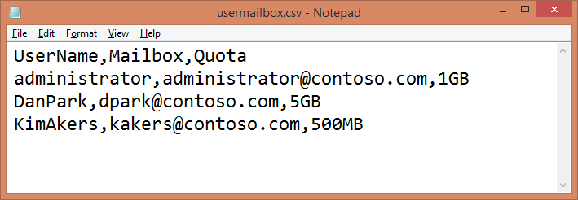
CSV vs. CliXML
CSV is simple and easier to work with
Can export to be read/manipulated in Excel
You can create and import custom CSVs into objects
PS C:\> Import-Csv C:\usermailbox.csv | Select-Object mailbox
Mailbox
-------
administrator@contoso.com
dpark@contoso.com
kakers@contoso.com
Notes:
CSVs are usually the easier choice, unless you have a reason to need XML data
Reading/manipulating data in excel is easy to do from export-CSV
Consuming custom data, such as a list of new hires who need AD accounts, is very easy as a CSV and can enable convenient automation tools.

Slide 12
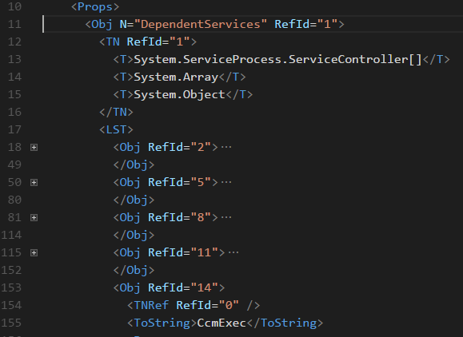
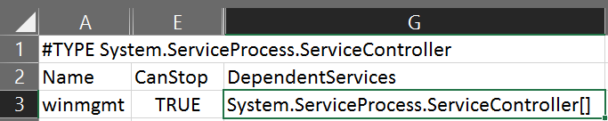
When to use CliXML?
XML is much better at representing hierarchical data (ex. Dependent services)
Notes:
Get-service winmgmt | select dependantservices
The CSV can’t display that data
The XML can, in the <OBJ M=“DependantServices”> tag we can see a child <LST>
<LST> shows us all the dependence services as separate <OBJ> tags
The button one, RefID=“14” is expanded to show the service name “CcmExec”

Slide 13
Content Cmdlets
Name | Description | Example
Get-Content | Retrieve item content | PS C:\> Get-Content C:\Logs\Log060912.txt -TotalCount 50
Add-Content | Add content to item | PS C:\> Get-Content test.xml | Add-Content final.xml -Force -Encoding UTF8
Clear-Content | Delete content from item | PS C:\> Clear-Content C:\Windows\Logs\bpa\Reports\* -Include 2013* -Exclude 2014*
Set-Content | Change item content | PS C:\> Get-Date | Set-Content C:\Output\date.csv
Notes:
Point out that SET will remove the data and replace it with the new value
Great to clear a log out, and write in customer headers if you write CSV data by hand to the log

Slide 14
Out Cmdlets
Sends command output to a specified device
Name | Description
Out-File | Sends output to a file Append switch parameter Encoding parameter allows control of the character encoding
Out-GridView | Sends output to an interactive table in a separate GUI
Out-Default | Sends output to default formatter and to default output cmdlet (Out-Host)
Out-Host | Default Sends output to PowerShell host Paging switch parameter displays one page at a time
Out-Null | Deletes output instead of sending it down the pipeline
Out-Printer | Sends output to a printer
Out-String | Sends objects to the host as a series of strings
Notes:
De-emphasize printer and string
Point out that default is host, so any data you leave alone ($MyVar) just gets dumped there.
I like to demo gridview

Slide 15
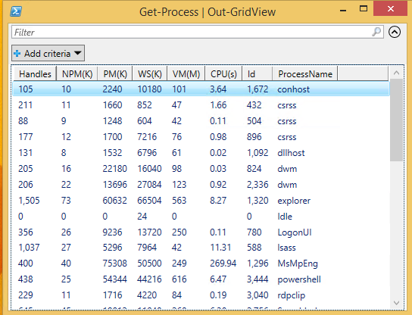
Out-Gridview
PS C:\> Get-Process | Out-GridView

Slide 16
Instructor Demonstration
DEMO
Statement Termination
Objective: Learn about the Pipeline
Demo Content: Interactive Demo
Instructions: Open the Demo code and follow along while the instructor demonstrates the concepts. Do not feel that you have to keep up with the instructor, the code merely provided for review purposes. The concepts covered in the Demo code will also be re-visited in the “Fundamental Recap” during the Lab.
To Open the Demo Run:
PS C:\> Start-WPLUSLabs -Module Module_04 -Task Demo_02
Notes:
Show FT vs. FL (I like to use the same get-process line from earlier)
Show selecting different properties and –wrap
Show format-wide (I like dir or get-alias)
Export-csv and open in excel
Import-Csv and pipe into select object
Import-csv some custom data for select object
Demo out-gridview with and without -passthrough

Slide 17
Module 4: Pipeline Introduction
Lab Content: Interactive Demos/Labs
Instructions: Open the Lab code and perform the operations at your own pace. Afterwards you may review the Demos again until the next block of instruction begins.
To Open the Lab Run:
Lab
PS C:\> Start-WPLUSLabs -Module Module_01 -Task Lab_01
Notes:
Instructor notes: Stress the point of this lab is to become comfortable with using the pipe and the out/export commands will be useful for data logging.
Lab:
Start a process and then grab a process and pipe it to stop process
get-history 10 | invoke-history
Cmdlet to Cmdlet Piping
Lesson 2: Pipeline Object Manipulation
Group Services by Status
Sort Files by Name, LastAccessTime, Length
Sum files in a directory using Measure Object
Adv: Grab Largest File and Look at All Properties
Adv: What is the Sum of dlls in System32 (filesize) Adv: What are the two ways to count the errors in the application log (Parameter | Measure-Object and Group)
Lesson 3: Pipeline Output
Export and Work with CSV and Sort, manipulate data.
Create CSV and import csv and manipulate data
Run Formatting Cmdlets on their CSV
Create File with Out-File
Stop Services/delete files/stop processes using Out-GridView –PassThru piped to another command.
Export Cmdlets
New-Item -ItemType File -Path .\file.txt | out-null (mkdir as well)
Out Cmdlets
Adv:
Find the 5 largest files and export to CSV

